Slide 1

Making the Most of Advice:
New Correlation Breakers and Their Applications
  Gil Cohen

Slide 2

Correlation Breakers
  Gil Cohen
DISCLAIMER: This is not an extractors’ talk!
Our correlation breakers may contain seeds of extractors.

Slide 3




Correlation Breakers
$$X$$
CB
$$f\left(X\right)=$$
$$X′$$
CB
Correlation Breakers
Doesn’t exist!
$$X\sim U \underset{⇒}{} ∀f \left(CB\left(X\right), CB\left(f\left(X\right)\right)\right) \sim U×CB\left(f\left(X\right)\right)$$
Even better!!

Slide 4
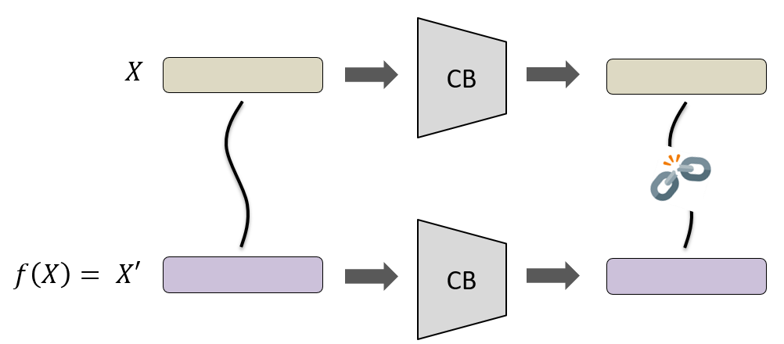
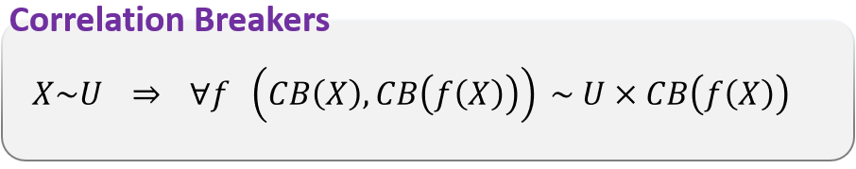

Correlation Breakers
Extractors
Correlation breakers
A 1-source extractor for general sources does not exist.
A CB for general functions does not exist.
* Seeded extractors
* Seeded CB
* Multi-source extractors
* Multi-source CB
* Extractors for structured sources
* Extractors for restricted $f$’s
* Implicit restricted CB [Dziembowski-Pietrzak’07], [Dodis-Wichs’09], [Li’12].
* Local CB and the flip-flop primitive [C’15a].
* CB with advice [Chattopadhyay-Goyal-Li’15], [C’15b].

Slide 5







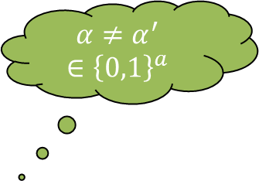


Correlation Breakers with Advice
$$α≠α^{′}∈{\left\{0,1\right\}}^{a}$$
$$Y$$
$$α$$
$$X$$
CB
$$f\left(X\right)=$$
$$X′$$
CB
$α$’
$$Y$$
$$g\left(Y\right)=Y′$$

Slide 6
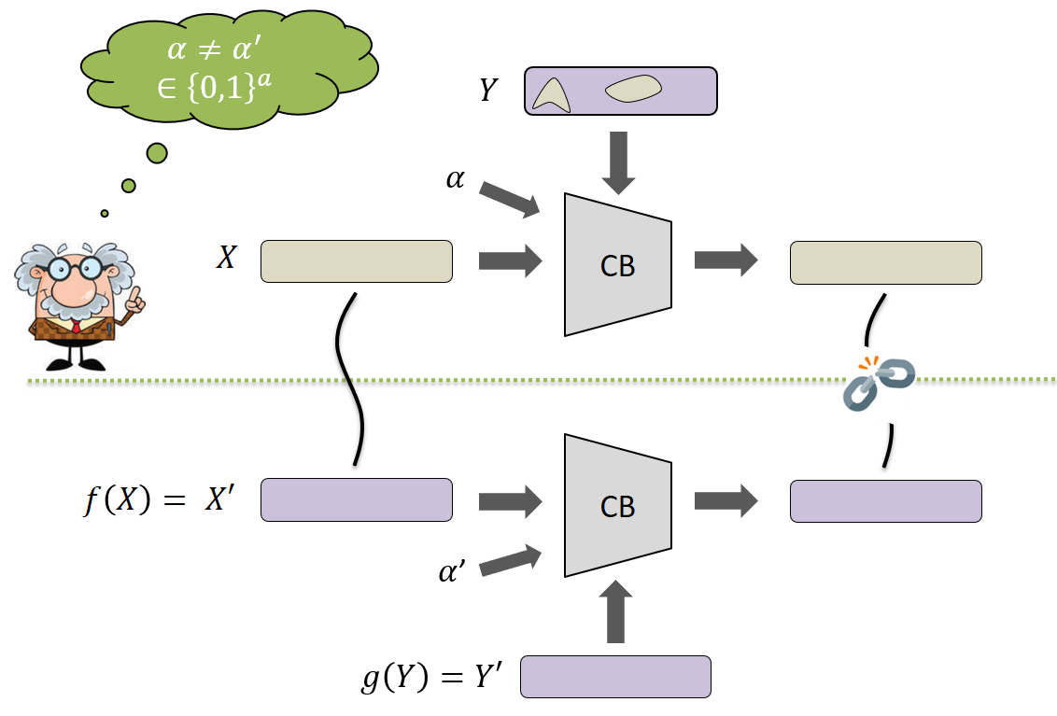
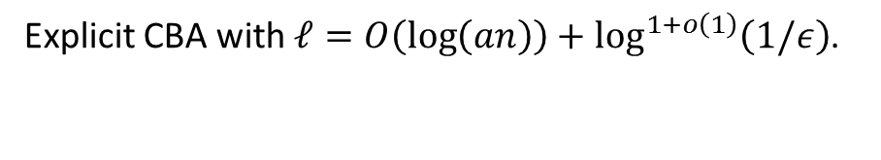


Correlation Breakers with Advice
Correlation breakers with advice
$X\sim U_{ℓ}$, $Y$ is an $n$-bit $0.9n$-source independent of $X$.
$$∀f,g ∀α≠α^{′} \left(CB\left(X,Y,α\right), CB\left(f\left(X\right),g\left(Y\right),α^{′}\right)\right) \sim _{ε} U×CB\left(f\left(X\right),g\left(Y\right),α′\right)$$
Fact
Main result
There exists CBA with $ℓ=O\left(\log\left(an/ε\right)\right).$
Explicit CBA with $ℓ=O\left(\log\left(an\right)\right)+\log^{1+o\left(1\right)}\left(1/ε\right)$.
Prior work [Chattopadhyay-Goyal-Li’15]
Explicit CBA with $ℓ=O\left(a⋅\log\left(an/ε\right)\right)$.

Slide 7
Our Contributions
Result 1 - CBA
Explicit CBA with $ℓ=O\left(\log\left(an\right)\right)+\log^{1+o\left(1\right)}\left(1/ε\right)$.
Result 2 – Multi-source extractors
Explicit 5-source extractor for min-entropy ${\left(\log{n}\right)}^{1+o\left(1\right)}$.
[Chattopadhyay-Goyal-Li’15], [C’15]
Corollary 1 – Non-malleable extractors
Explicit non-malleable extractors with seed length $O\left(\log{n}\right)+{\left(\log\left(1/ε\right)\right)}^{1+o\left(1\right)}$.
[Dodis-Wichs’09]
Corollary 2 – Privacy amplification protocols
Near-optimal privacy amplification protocols against active adversaries.

Slide 8
High-Level Overview of the Construction

Slide 9

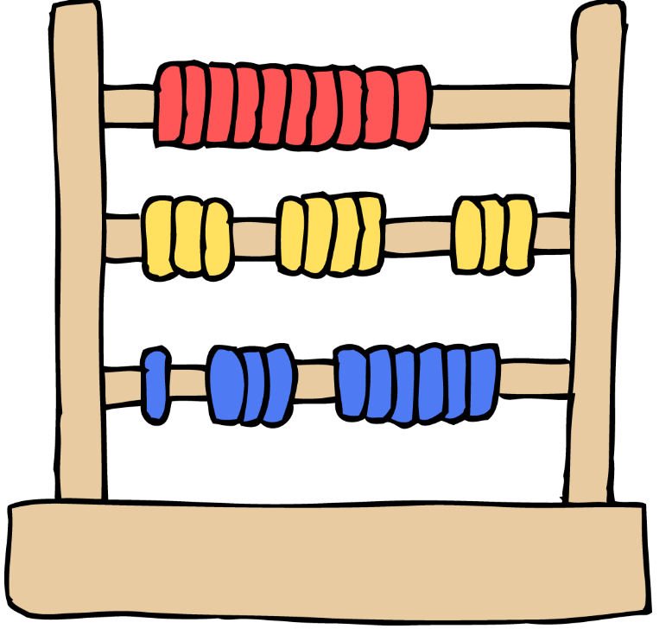






Step 1 – Stepping-up CBA
$$ℓ \sim a$$
$$ℓ \sim 2{⋅a}^{1/2}$$
$$ℓ \sim 2^{2}⋅a^{1/3}$$
IPM
$$ℓ \sim 2^{r−1}⋅a^{1/r}$$
$$ℓ \sim 2^{\sqrt{\log{a}}}$$
$$ℓ \sim \log{a}$$

Slide 10












Step 2 – Condensing the Advice
$$α_{0}$$
$$a$$
$$Y$$
$$X$$
$$α_{1}$$
$$\log{a}+\log\left(1/ε\right)$$
$$α_{2}$$
$$\log{\log{a}}+\log\left(1/ε\right)$$
$$α_{r}$$
$$\log^{(r)}{a}+\log\left(1/ε\right)$$
$$ℓ \sim 2^{\sqrt{\log{a}}}$$
$$ℓ \sim \log{a}+ 2^{\sqrt{τ(a)+\log{\log\left(1/ε\right)}}}$$

Slide 11








Step 1 – Stepping-up CBA
$$α$$
CB
$$α_{1}$$
CB
IPM
$$α_{2}$$
$$α_{\sqrt{a}}$$
CB
$$ℓ \sim a$$
$$Y$$
IPM
$$X$$
$$ℓ \sim 2{⋅a}^{1/2}$$

Slide 12
Summary
My outlook
Breaking correlations is as fundamental as extracting randomness.
More on my outlook
Future research
* Merging is natural.
A systematic study of CB.
* Preserving an already obtained independence is desired.
New applications!
* IPM is a natural, desired, primitive.
This work
Multi-source extractors
Non-malleable extractors
Thanks!
[C’16]

