Slide 1

Gradual Small-Bias
Sample Spaces
  Gil Cohen
  Weizmann Institute
  Joint work with
  Avraham Ben-Aroya

Slide 2
Randomness
and
Pseudo-randomness

Slide 3
Randomness
Shannon Entropy
Renyi Entropy
Statistical closeness to the uniform distribution

Slide 4
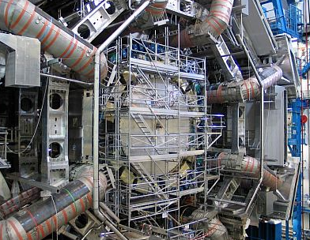

Pseudo-randomness
Randomness is in the eyes of the beholder!

Slide 5
Who do we want to fool?
Polynomial-time algorithms
Algorithms with “local view” on the random bits
Restricted circuits
Low degree polynomials
Linear functions

Slide 6








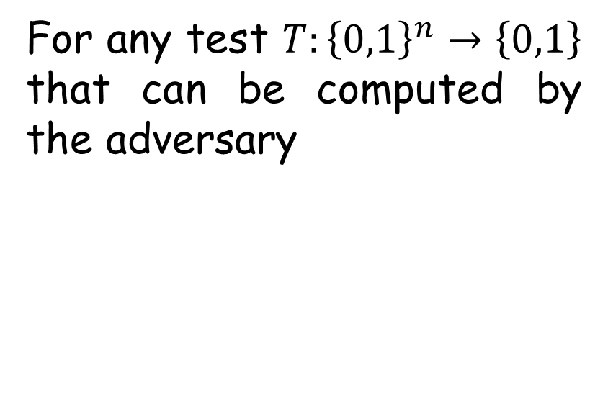





What does it mean “to fool”?
$$1 2$$
$$n$$
$$0 1 1 1 0 1 0 0 1 0 1$$
For any test $T:{\left\{0,1\right\}}^{n}→\left\{0,1\right\}$ that can be computed by the adversary
$$1 0 1 0 1 0 0 1 1 1 1$$
$$1 1 1 0 1 0 0 0 0 1 0$$
sample
space
size
$$1 1 0 1 0 1 1 1 0 1 0$$
$$0 0 1 0 1 1 0 1 0 1 1$$
$$1 0 0 1 1 0 0 0 1 0 0$$
$$\left|\underset{s\sim S}{E}\left[T\left(s\right)\right]−\underset{s\sim U_{n}}{E}\left[T\left(s\right)\right]\right|≤ε$$
$$1 0 1 0 0 1 1 0 0 1 1$$
$$0 1 1 0 1 0 0 0 0 0 1$$
$$1 0 0 1 0 1 1 1 1 1 1$$
$$0 1 1 1 0 0 0 1 0 0 0$$

Slide 7
Small-Bias Sample Spaces

Slide 8

























Small-bias sample spaces
Def [NN93]: A sample space $S⊆{\left\{0,1\right\}}^{n}$ is called $ε$-biased if $∀∅≠T⊆\left[n\right]$
$$bias_{S}\left(T\right)≜\left|E_{s\sim S}\left[{\left(−1\right)}^{\sum_{i∈T}{s_{i}}}\right]\right|≤ε$$
$$1 2 3 4 5 6 7 8 9⋯$$
$$0 1 1 1 0 1 0 0 1 0 1$$
$$1$$
$$bias_{}\left(\left\{1,3,8\right\}\right)=\frac{1}{5}$$
$$1 0 1 0 1 0 0 1 1 1 1$$
$$1$$
$$1 1 1 0 1 0 0 0 0 1 0$$
$$0$$
$$1 1 0 1 0 1 1 1 0 1 0$$
$$0$$
$$0 0 1 0 1 1 0 1 0 1 1$$
$$0$$
$$1 0 0 1 1 0 0 0 1 0 0$$
$$1$$
Many applications [NN93, BNS92, HPS93, AR94, MW02, BSSVW03, W08, Vio09] to name a few.
$$1 0 1 0 0 1 1 0 0 1 1$$
$$0$$
$$0 1 1 0 1 0 0 0 0 0 1$$
$$1$$
$$1 0 0 1 0 1 1 1 1 1 1$$
$$0$$
$$0 1 1 1 0 0 0 1 0 0 0$$
$$0$$

Slide 9









Fourier perspective
A small-bias sample space has all its non-empty Fourier coefficients small.
$$1$$
$$ε$$
$$0$$
$$W_{1}$$
$$W_{2}$$
$$⋯$$
$$W_{k}$$
$$W_{k+1}$$
$$W_{n}$$

Slide 10
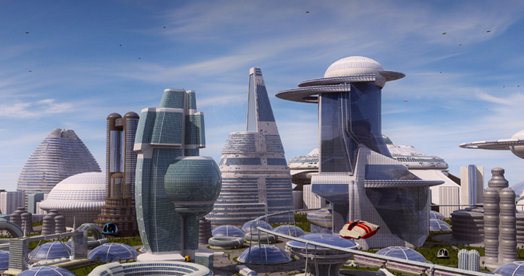
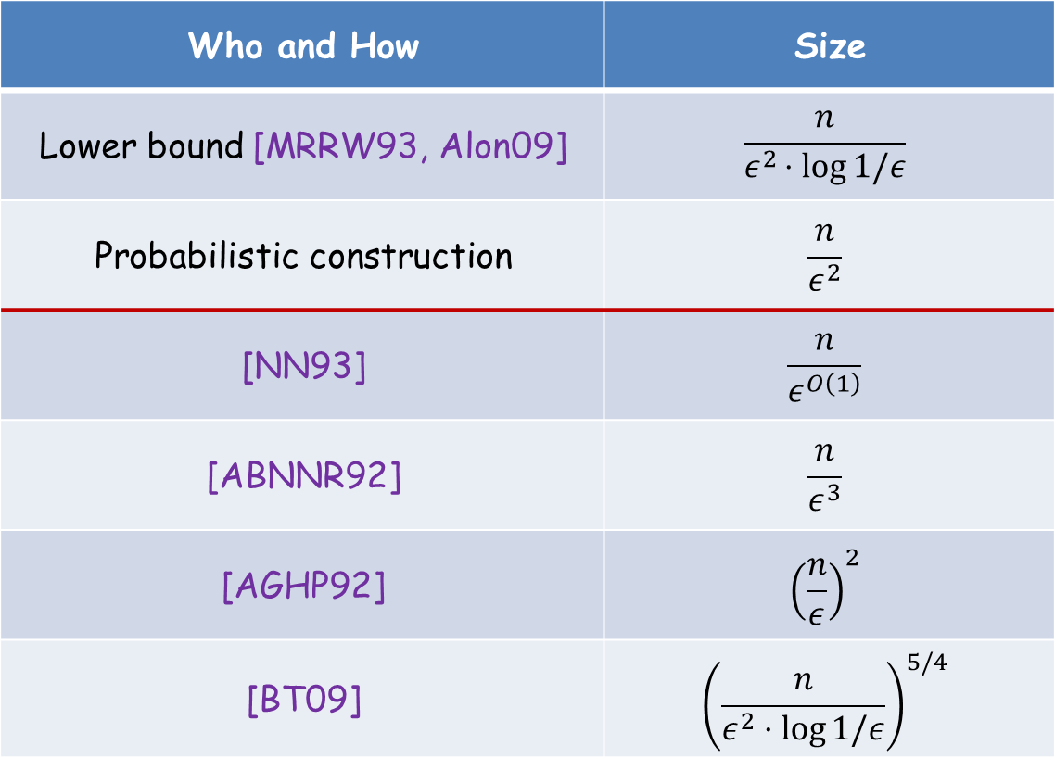
Small-bias sample spaces
Size | Who and How
$$\frac{n}{ε^{2}⋅log{1/ε}}$$ | Lower bound [MRRW93, Alon09]
$$\frac{n}{ε^{2}}$$ | Probabilistic construction
$$\frac{n}{ε^{O\left(1\right)}}$$ | [NN93]
$$\frac{n}{ε^{3}}$$ | [ABNNR92]
$${\left(\frac{n}{ε}\right)}^{2}$$ | [AGHP92]
$${\left(\frac{n}{ε^{2}⋅\log{1/ε}}\right)}^{5/4}$$ | [BT09]

Slide 11

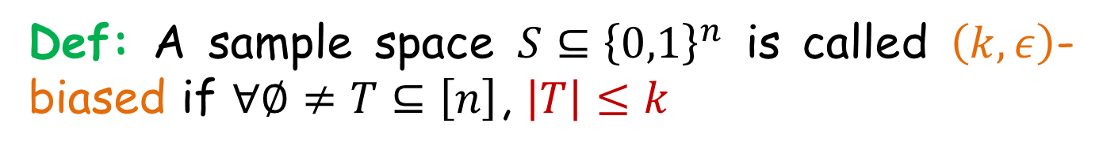

Fooling small linear tests
Def: A sample space $S⊆{\left\{0,1\right\}}^{n}$ is called $\left(k,ε\right)$-biased if $∀∅≠T⊆\left[n\right]$, $\left|T\right|≤k$
$$bias_{S}\left(T\right)≤ε$$
The goal is to get a sample space with sub-linear dependency in $n$.
Numerous applications [NN93, SZ94, Raz05, CRS12].

Slide 12
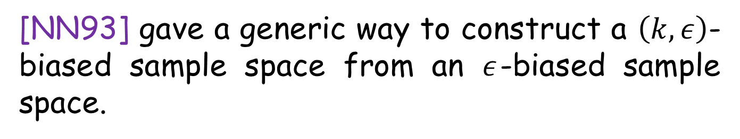

Fooling small linear tests
[NN93] gave a generic way to construct a $\left(k,ε\right)$-biased sample space from an $ε$-biased sample space.
$s_{1}$ $s_{2}$ $s_{3}$ $s_{4}$ $⋯$
$s_{1}+s_{2}+s_{5}+s_{9}$ ${s_{2}+s}_{3}+s_{7}$ $⋯$
The sum of any (at most) $k$ linear combinations must be non-zero.
The more linear combinations – the better.

Slide 13


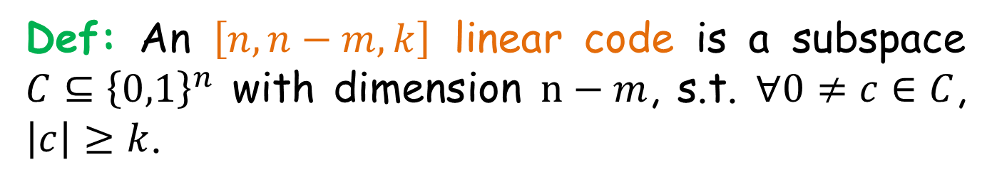




Parity-check matrix
Def: An $\left[n,n−m,k\right]$ linear code is a subspace $C⊆{\left\{0,1\right\}}^{n}$ with dimension $n−m$, s.t. $∀0≠c∈C$, $\left|c\right|≥k$.
$$n$$
.
$$m$$
$$H$$
=
$$x$$
$$0$$
$$k−1$$
$$C=\left\{x∈{\left\{0,1\right\}}^{n} : Hx=0\right\}$$

Slide 14


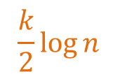

Parity-check matrix
[NN93] Suggested taking a BCH code.
$$n$$
$$\frac{k}{2}\log{n}$$
$$H$$
Using [AGHP92] we get a $\left(k,ε\right)$-biased sample space with size$O{\left(k⋅\log{n}⋅ε^{−1}\right)}^{2}$ compared with $Ω\left(n⋅ε^{−2 }\right)$ for $ε$-biased sets.

Slide 15
Gradual Small-Bias Sample Spaces

Slide 16








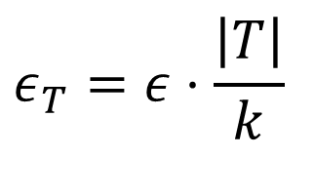

Gradual small-bias sample spaces
The seed length used for a $\left(k,ε\right)$-biased sample space is $s=\log{\log{n}}+\log{k}+\log{1/ε}$.
$$\log{\log{n}}$$
$$\log{k}$$
$$\log{1/ε}$$
Facing a test $T$ with size $<k$, we wish we would have invested more of the seed to reduce the error..
$$\log{\log{n}}$$
$$\log\left|T\right|$$
$$\log{1/ε_{T}}$$
$$s=\log{\log{n}}+\log{k}+\log{\frac{1}{ε}}$$
$=\log{\log{n}}+\log\left|T\right|+\log{\frac{k}{ε⋅\left|T\right|}}$
$$ε_{T}=ε⋅\frac{\left|T\right|}{k}$$

Slide 17

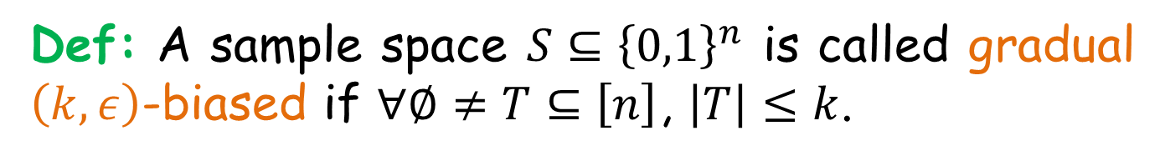
Gradual small-bias sample spaces
Def: A sample space $S⊆{\left\{0,1\right\}}^{n}$ is called gradual $\left(k,ε\right)$-biased if $∀∅≠T⊆\left[n\right]$, $\left|T\right|≤k$.
$$bias_{S}\left(T\right)≤ε⋅\frac{\left|T\right|}{k}$$
Wait..
why linear decay?

Slide 18

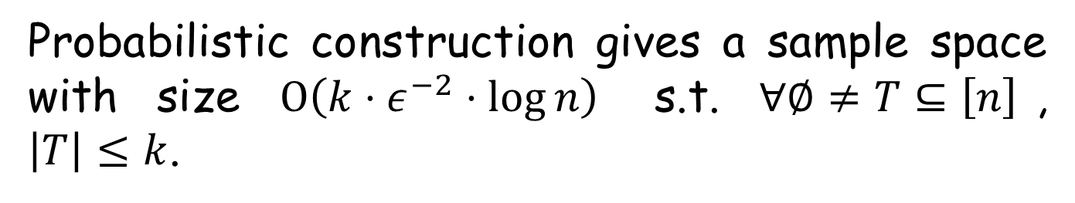
Gradual small-bias sample spaces
Probabilistic construction gives a sample space with size $O\left(k⋅ε^{−2}⋅\log{n}\right)$ s.t. $∀∅≠T⊆\left[n\right]$, $\left|T\right|≤k$.
$$bias_{S}\left(T\right)≤ε⋅{\left(\frac{\left|T\right|}{k}\right)}^{1/2}$$

Slide 19




Amplifying the decay exponent
Method 1: Take a gradual $\left(k,ε/k\right)$-biased sample space $S$.
$$bias_{S}\left(T\right)≤\frac{ε}{k}⋅\frac{\left|T\right|}{k}≤ε⋅{\left(\frac{\left|T\right|}{k}\right)}^{2}$$
Method 2: Take a gradual $\left(k,\sqrt{ε}\right)$-biased sample space $S$, and consider $S+S$.
$$bias_{S+S}\left(T\right)≤{\left(\sqrt{ε}⋅\frac{\left|T\right|}{k}\right)}^{2}=ε⋅{\left(\frac{\left|T\right|}{k}\right)}^{2}$$

Slide 20



Fourier perspective
A small-bias sample space has all its non-empty Fourier coefficients small.
A gradual small-bias sample space has smaller Fourier coefficients in lower levels.
$$1$$
$$ε$$
$$ε⋅\left(\left|T\right|/k\right)$$
$ε⋅{\left(\left|T\right|/k\right)}^{2}$
$$0$$
$$W_{1}$$
$$W_{2}$$
$$⋯$$
$$W_{k}$$
$$W_{k+1}$$
$$W_{n}$$

Slide 21
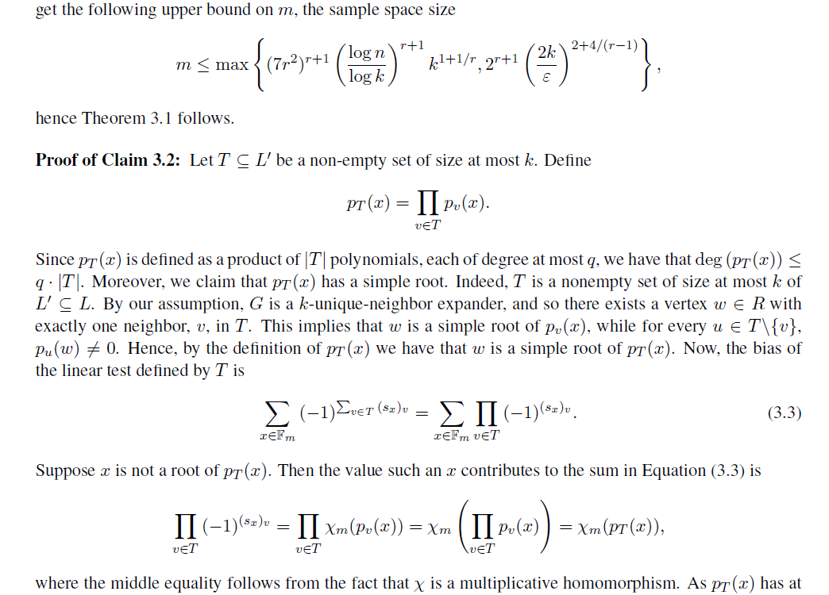
Main Result

Slide 22
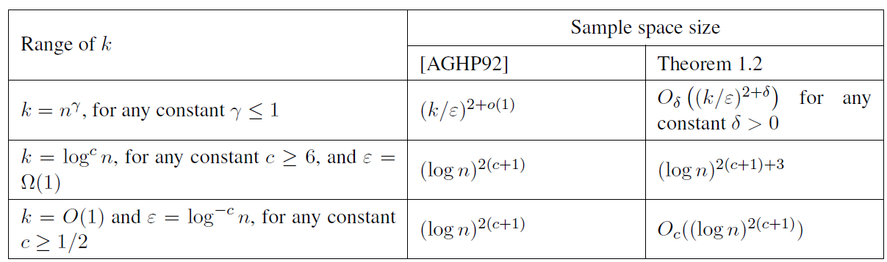
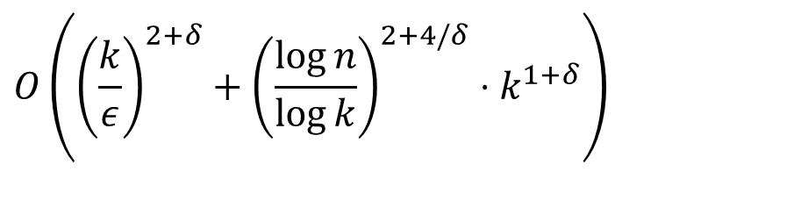


Main result
Thm: $∀n,k,ε$ and $∀$ constant $δ>0$, there exists an explicit construction of a gradual $\left(k,ε\right)$-biased sample space in ${\left\{0,1\right\}}^{n}$, with size
$$O\left({\left(\frac{k}{ε}\right)}^{2+δ}+{\left(\frac{\log{n}}{\log{k}}\right)}^{2+4/δ}⋅k^{1+δ}\right)$$
Compare with the non-gradual construction of [AGHP92].
$$O\left({\left(\frac{k}{ε}⋅\log{n}\right)}^{2}\right)$$

Slide 23
Constructing gradual small-bias sample spaces
[NN93] strategy:
Construct a small-bias sample space.
Apply a code (BCH) to get more output bits.
We use a similar idea:
Construct a gradual small-bias sample space.
Apply a “gradual-preserving” code to get more output bits.

Slide 24
- Step I -
Quadratic Character Construction

Slide 25
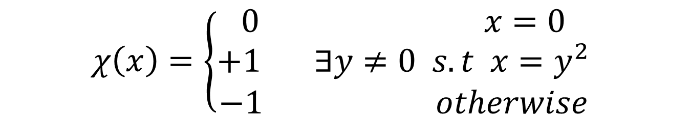


Quadratic characters
Let $q$ be an odd prime power. The quadratic character $χ:F_{q}→\left\{−1,0,1\right\}$ is defined by
$$χ\left(x\right)=\left\{\begin{aligned}0 x=0 \\ +1 ∃y≠0 s.t x=y^{2} \\ −1 otherwise\end{aligned}\right.$$
Observation: $∀a,b∈F_{q} χ\left(a⋅b\right)=χ\left(a\right)⋅χ\left(b\right)$

Slide 26


Quadratic characters
Observation:
$$\sum_{x∈F_{q}}{χ\left(x\right)}=0$$
In fact: $∀a≠0,b∈F_{q}$
$$\sum_{x∈F_{q}}{χ\left(ax+b\right)}=0$$

Slide 27

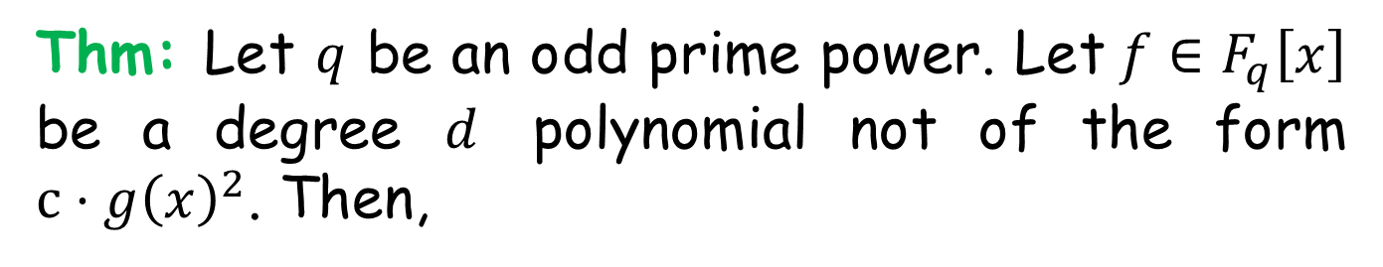
Weil’s theorem
Thm: Let $q$ be an odd prime power. Let $f∈F_{q}\left[x\right]$ be a degree $d$ polynomial not of the form $c⋅g{\left(x\right)}^{2}$. Then,
$$\left|\sum_{x∈F_{q}}{χ\left(f\left(x\right)\right)}\right|≤\left(d−1\right)\sqrt{q}$$

Slide 28
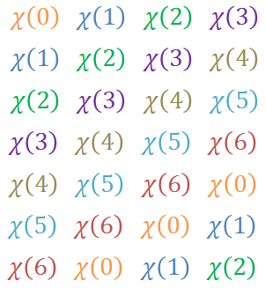








Quadratic character construction
Construction [AGHP92]: Let $q$ be an odd prime power. $∀x∈F_{q}$ define $s_{x}∈{\left\{0,1\right\}}^{n}$ as follows
$$s_{0}=$$
$$s_{1}=$$
$$s_{2}=$$
$$s_{3}=$$
$$s_{4}=$$
$$s_{5}=$$
$$s_{6}=$$

Slide 29
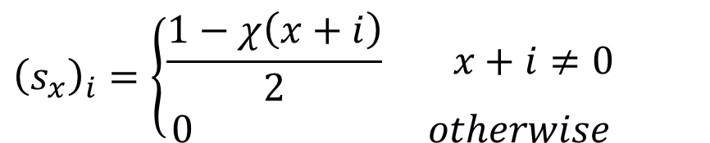

Quadratic character construction
Construction [AGHP92]: Let $q$ be an odd prime power. $∀x∈F_{q}$ define $s_{x}∈{\left\{0,1\right\}}^{n}$ as follows
$${\left(s_{x}\right)}_{i}=\left\{\begin{aligned}\frac{1−χ\left(x+i\right)}{2} x+i≠0 \\ 0 otherwise\end{aligned}\right.$$
Thm: ${bias}_{S}\left(T\right)≤\frac{\left|T\right|}{\sqrt{q}}$

Slide 30
- Step II -
Unbalanced Expanders

Slide 31



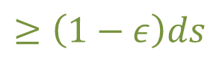


Unbalanced expanders
$$n$$
$$m$$
$$≥\left(1−2ε\right)ds$$
unique neighbors
$$d$$
$$≥\left(1−ε\right)ds$$
$$s≤k$$
State of the art explicit construction [GUV06].
Many applications [UW87, SS96, AR01, BSW01, BMRV02, ABSRW04, LMSS01] to name a few.

Slide 32
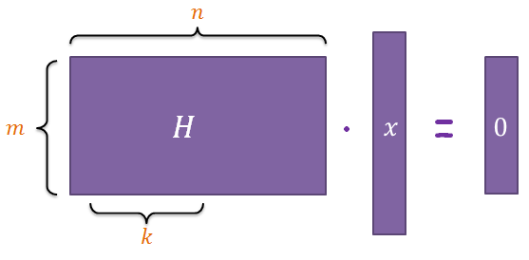
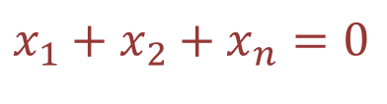



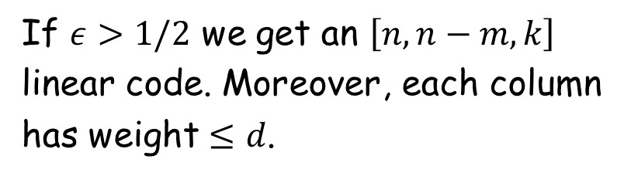

LDPC codes from unbalanced expanders [SS96]
$$n$$
$$m$$
$$x_{1}$$
$$x_{1}+x_{2}+x_{n}=0$$
$$x_{2}$$
check node
$$x_{3}$$
If $ε>1/2$ we get an $\left[n,n−m,k\right]$
linear code. Moreover, each column
has weight $≤d$.
$$x_{n}$$

Slide 33



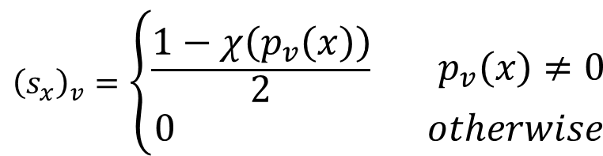

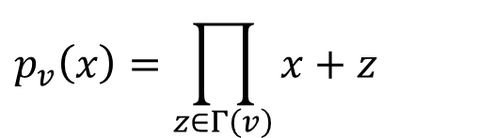
Unfolding the construction
$$n$$
$$F_{m}$$
$$p_{v}\left(x\right)=\prod_{z∈Γ\left(v\right)}{x+z}$$
$$v$$
$${\left(s_{x}\right)}_{v}=\left\{\begin{aligned}\frac{1−χ\left(p_{v}\left(x\right)\right)}{2} p_{v}\left(x\right)≠0 \\ 0 otherwise\end{aligned}\right.$$
$$T$$

Slide 34


Unfolding the construction
$$n$$
$$F_{m}$$
$$p_{v}\left(x\right)=\prod_{z∈Γ\left(v\right)}{x+z}$$
$$v$$
$${\left(s_{x}\right)}_{v}=\left\{\begin{aligned}\frac{1−χ\left(p_{v}\left(x\right)\right)}{2} p_{v}\left(x\right)≠0 \\ 0 otherwise\end{aligned}\right.$$
$$T$$
$$p_{T}\left(x\right)=\prod_{v∈T}{p_{v}\left(x\right)}$$
By the unique neighbor property, $p_{T}\left(x\right)$ has a simple root. Moreover, $\deg{p_{T}\left(x\right)}≤d⋅\left|T\right|$ - apply Weil’s thm.

Slide 35
Open Problems

Slide 36
Open problems
? Match the non-gradual [AGHP92] construction (can be done given probabilistic constructions of unbalanced expanders).
? Match any non-gradual construction (one route is to find another gradual small-bias sample space).
? Applications would be appreciated ☺

Slide 37
Thank You!

